Slide 1
بِسمِ اللهِ الرَّحمٰنِ الرَّحِيمِ
اوَل اَلله ، عليم ، اعليٰ ، عالم ، جو ڌڻي،
قادر پنهنجي قُدرت سين ، قائم آهي قديم،
والي ، واحِد ، وَحده‘ ، رازق ، رب ، رحيم،
سو ساراهِ سچو ڌڻي ، چئي حمّد حڪيم،
ڪري پاڻ ڪريم، جوڙُون، جوڙ جھان جون.
(شاه سائين)

Slide 2
Comparative performance of new promising sugarcane line HoTh-409 at different agro - climatic conditions of Sindh
By:
Muhammad Chohan
Salahuddin Junejo
Ghulam Sarwar Unar
Ubedullah Anwar Talpur
Riaz Noor Panhwar
National Sugar Crops Research Institute Thatta
Pakistan Agricultural Research Council

Slide 3
Sugarcane over view
Sugarcane )Saccharum officenarum L.( is a tropical giant perennial grass belonging to family graminae/poaceae.
Sugarcane is an important cash crop globally not only for sugar production, but also increasingly as a bioenergy crop due to its phenomenal dry matter production and also known as companion crop.
Its major byproduct molasses and baggase get important position now and used as a source of energy.
The national average cane yield (49.00 t ha⁻¹) and sugar recovery (9.46%) is much lower than the other sugarcane growing countries of the world.
The prominent factors contributing to low cane tonnage and sugar recovery are inherently low yielding varieties, lack of insect pest diseases resistance and stress tolerance varieties and substandard methods of farming.

Slide 4
Introduction
National Sugar crops Research Institute, Thatta working on development of new high yield and sugar content varieties since 1999.
The development is done by sexual means and propagated vegetatively from fuzz (true seed) is collected locally or from abroad.
Thousands of seedlings are raised and the seedlings are pass through the different selection stages in subsequent year to year.
Major criteria for advancement from one stage to the next are high yields, quality index, disease resistance or tolerance and agronomic traits .
The yielding ability of sugarcane varieties is strongly influenced by environment variation, so replicated trial at different locations are necessary to assess characters accurately .
The time taken to release a sugar cane variety ranges from eight to twenty years .

Slide 5
Selection criteria
From single plant to 3rd cycle: (Non Replicated)
Girth thick to medium
High Brix %
No pith
Insect pest diseases resistance.
From 4th cycle to Zonal trial: (Replicated)
Girth
Height
No. of internodes per plant
Millable cane tha⁻¹
CCS%
Cane yield tha⁻¹
Sugar yield tha⁻¹
Insect pest diseases resistance
Stress and salinity tolerance
Nutrient requirement
Ratoon ability

Slide 6
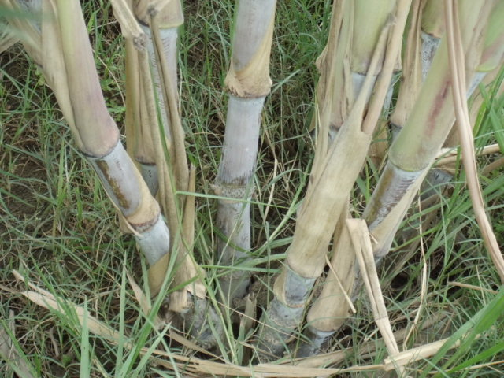
General characteristics HoTh-409
Cross Name: H92-867
Parentage : CP-76-1628 X CP-87-1625
Single plant 16000
1st cycle 1112
2nd cycle 183
3rd cycle 62
4th cycle 24
Germination: 72 %
Leaves: Broad
Girth: Thick
Height: Tall
Internode: long
Tillers: Good
Millable canes: High number
Brix %: High
Ratoon ability: Good
Others: Erect, no pith self trashed

Slide 7
Table-1: Comparative performance of HoTh-409 against two local check Th-10 & BL-4 varieties in 4th stage for plant and ratoon crop during 2004-05
Name of trial | Yield tha⁻¹ |  |  | % ± Th-10 | % ± BL-4 | Commercial Cane Sugar % |  |  | % ± Th-10 | % ± BL-4
 | HoTh-409 | Th-10 | BL-4 |  |  | HoTh-409 | Th-10 | BL-4
4th cycle | 110.0 | 85.00 | 75.00 | +29 | +46 | 14.27 | 14.74 | 13.21 | -3.18 | +8.0
4th ratoon | 82.00 | 75.00 | 69.00 | +9.3 | +18 | 14.39 | 12.19 | 10.89 | +18 | +32.
% ± ratoon | -34.14 | -3.33 | -8.69 |  |  | +0.83 | -20.91 | -21.30

Slide 8
Table-2: Comparative performance of HoTh-409 against local check Th-10 variety in preliminary , advance and NUVYT yield trials
Name of trial | Cane Yield tha⁻¹ |  | % ± | Commercial cane sugar % |  | % ±
 | HoTh-409 | Th-10 |  | HoTh-409 | Th-10
Preliminary Yield trial | 103.66 | 85.78 | + 20.84 | 14.21 | 13.84 | + 2.67
Advance varietal yield trial | 133.30 | 106.65 | +24.98 | 13.20 | 13.06 | + 1.07
NUVYT 2008-09 | 123.33 | 107.00 | +15.26 | 13.26 | 13.30 | -0.30
Average | 119.76 | 99.81 | +19.19 | 13.55 | 13.40 | +1.19

Slide 9
Table-3: Comparative performance of HoTh-409 against local check Th-10 variety at different locations of Sindh during 2005-06
Location | Cane Yield tha⁻¹ |  | % ± | Commercial cane sugar % |  | % ±
 | HoTh-409 | Th-10 |  | HoTh-409 | Th-10
Hussaini Farm Matiari | 143.00ab | 123.66bc | +15.63 | 13.82ab | 13.56b | +1.91
Keerio Farm Sanghar | 133.33abc | 114.00c | +16.95 | 13.55b | 13.78ab | -1.66
Bachani Farm Tando Allahyar | 155.00a | 118.00bc | +31.35 | 14.16ab | 13.90ab | +1.87
Bhurt Farm Naushehro Feroze | 120.34bc | 118.00bc | +1.97 | 14.74a | 14.00ab | +5.28
Sasui Palijo farm Thatta | 123.85bc | 110.80c | +11.77 | 14.02ab | 13.95ab | +0.50
Average | 135.10 | 116.89 | +15.57 | 14.05 | 13.83 | +1.59
CV% LSD 0.05 LS D 0.01 Relationship (r) | 9.31 20.04 27.46 0.505* |  |  | 4.39 0.64 NS 0.666**

Slide 10
Table-4: Comparative performance of HoTh-409 against local check Th-10 variety in ratoon crop at different locations of Sind
Location | Cane Yield tha⁻¹ |  | % ± | Commercial cane sugar % |  | % ±
 | HoTh-409 | Th-10 |  | HoTh-409 | Th-10
Hussaini Farm Matiari | 106.65abc | 128.33a | - 16.89 | 14.00 | 13.98 | +0.14
Keerio Farm Sanghar | 120.00ab | 106.65abc | +12.51 | 13.80 | 14.10 | - 2.12
Bachani Farm Tando Allahyar | 113.30abc | 96.65c | +17.22 | 14.43 | 14.01 | +2.99
Bhurt Farm Naushehro Feroze | 103.30bc | 91.65c | +12.71 | 14.90 | 14.12 | +5.52
Sasui Palijo farm Thatta | 105.65abc | 100.35bc | +5.28 | 14.14 | 14.00 | + 1.00
Average | 109.78 | 104.72 | +4.81 | 14.25 | 14.04 | +1.49
CV% LSD 0.05 LSD 0.01 Relationship (r) | 9.22 16.98 23.26 0.043 |  |  | 8.82 NS NS 0.359*

Slide 11
Table-5: Comparative performance of HoTh-409 against local check Th-10 variety at different locations of Sindh during 2007-2008
Location | Cane Yield tha⁻¹ |  | % ± | Commercial Cane Sugar % |  | % ±
 | HoTh-409 | Th-10 |  | HoTh-409 | Th-10
Rana farm Thatta | 136.65a | 112.00bc | +22.00 | 13.73 | 13.53 | +1.47
Raja Farm Badin | 111.75bc | 100.00c | +11.55 | 14.05 | 13.91 | +1.00
Bhurgri Farm Hyderabad | 135.00a | 123.30ab | +9.48 | 13.94 | 13.60 | +2.50
Jamali Farm, Thatta | 113.76bc | 95.00c | +19.74 | 13.94 | 13.79 | +1.08
Hot Farm Shaheed Benazirabad | 124.5ab | 107.00c | +16.35 | 14.00 | 13.98 | +1.43
Average | 124.29 | 107.57 | +15.54 | 13.91 | 13.70 | +1.53
CV% LSD 0.05 LSD 0.01 Relationship (r) | 10.56 21.17 29.00 0.897** |  |  | 4.89 NS NS 0.826**

Slide 12
Table-6: Comparative performance of HoTh-409 against local check Th-10 variety as a ratoon crop at different locations of Sind
Location | Cane Yield tha⁻¹ |  | % ± | Commercial cane sugar % |  | % ±
 | HoTh-409 | Th-10 |  | HoTh-409 | Th-10
Rana farm Thatta | 101.32a | 98.34ab | +3.03 | 14.33ab | 13.83bc | +7.49
Raja Farm Badin | 95.55ab | 97.43ab | -1.96 | 14.05ab | 13.81bc | +1.73
Bhurgri Farm Hyderabad | 85.33bc | 84.56bc | +0.91 | 14.56a | 14.05ab | +3.62
Jamali Farm, Thatta | 96.00ab | 85.00bc | +12.9 | 14.04ab | 13.90bc | +1.00
Hot Farm Shaheed Benazirabad | 88.65bc | 72.32c | +22.5 | 14.23ab | 13.56c | +4.94
Average | 93.37 | 87.53 | +6.67 | 14.24 | 13.83 | +2.96
CV % LSD 0.05 LSD 0.01 Relationship (r) | 7.73 9.34 12.8 0.551* |  |  | 5.66 0.62 NS 0.409*

Slide 13
Table-7: Screening against Insect pest and diseases at NSCRI, Thatta 2007-08
Name of line | Insect pest attack % |  |  | Mean infestation % | Remark | Whip smut
 | Top borer | Stem borer | Root borer |  |  | infestation % | Grading
HoTh-409 | 9.35 | 7.91 | 2.15 | 6.47 | LS | 0 | R
Th-10 | 8.57 | 7.85 | 4.28 | 5.17 | LS | 0.50 | R

Slide 14
General Suggestions
Plant population:
Sugarcane is companion crop:
Farm yard manure:
Ploughing:
Furrows size:
Seed rate:
Fertilizer doses:
Proper ratoon management:
Ratoon fertilizer doses:
During grand growth period:
Inter culturing and hoeing:

Slide 15
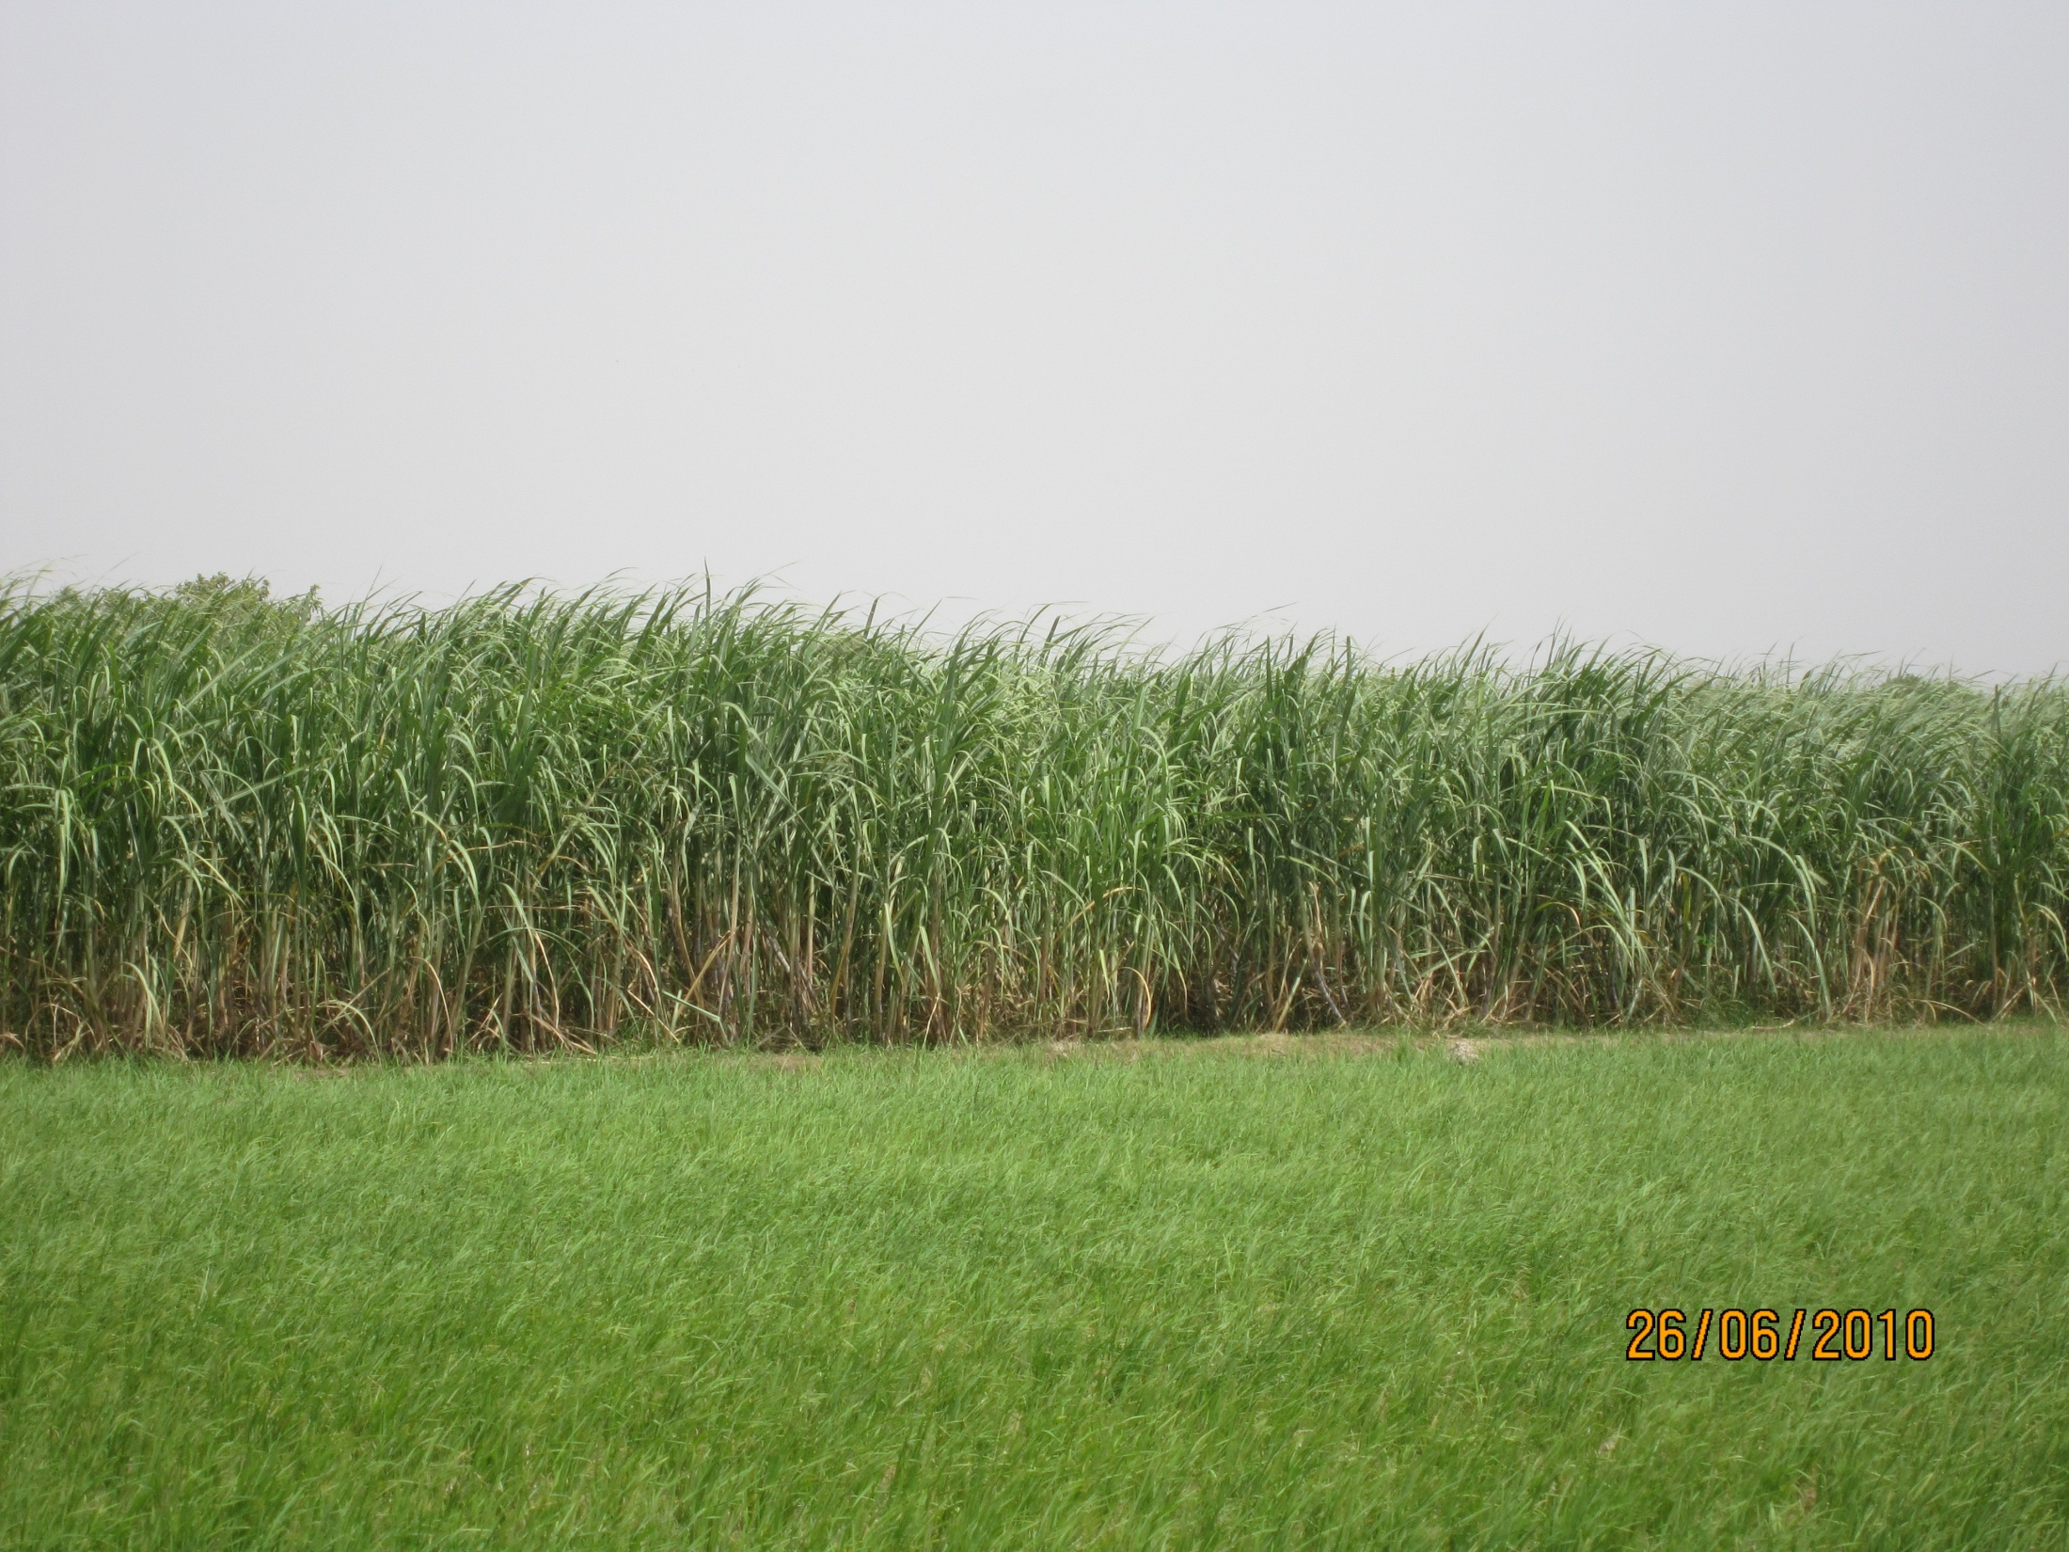
View of HoTh-409

Slide 16
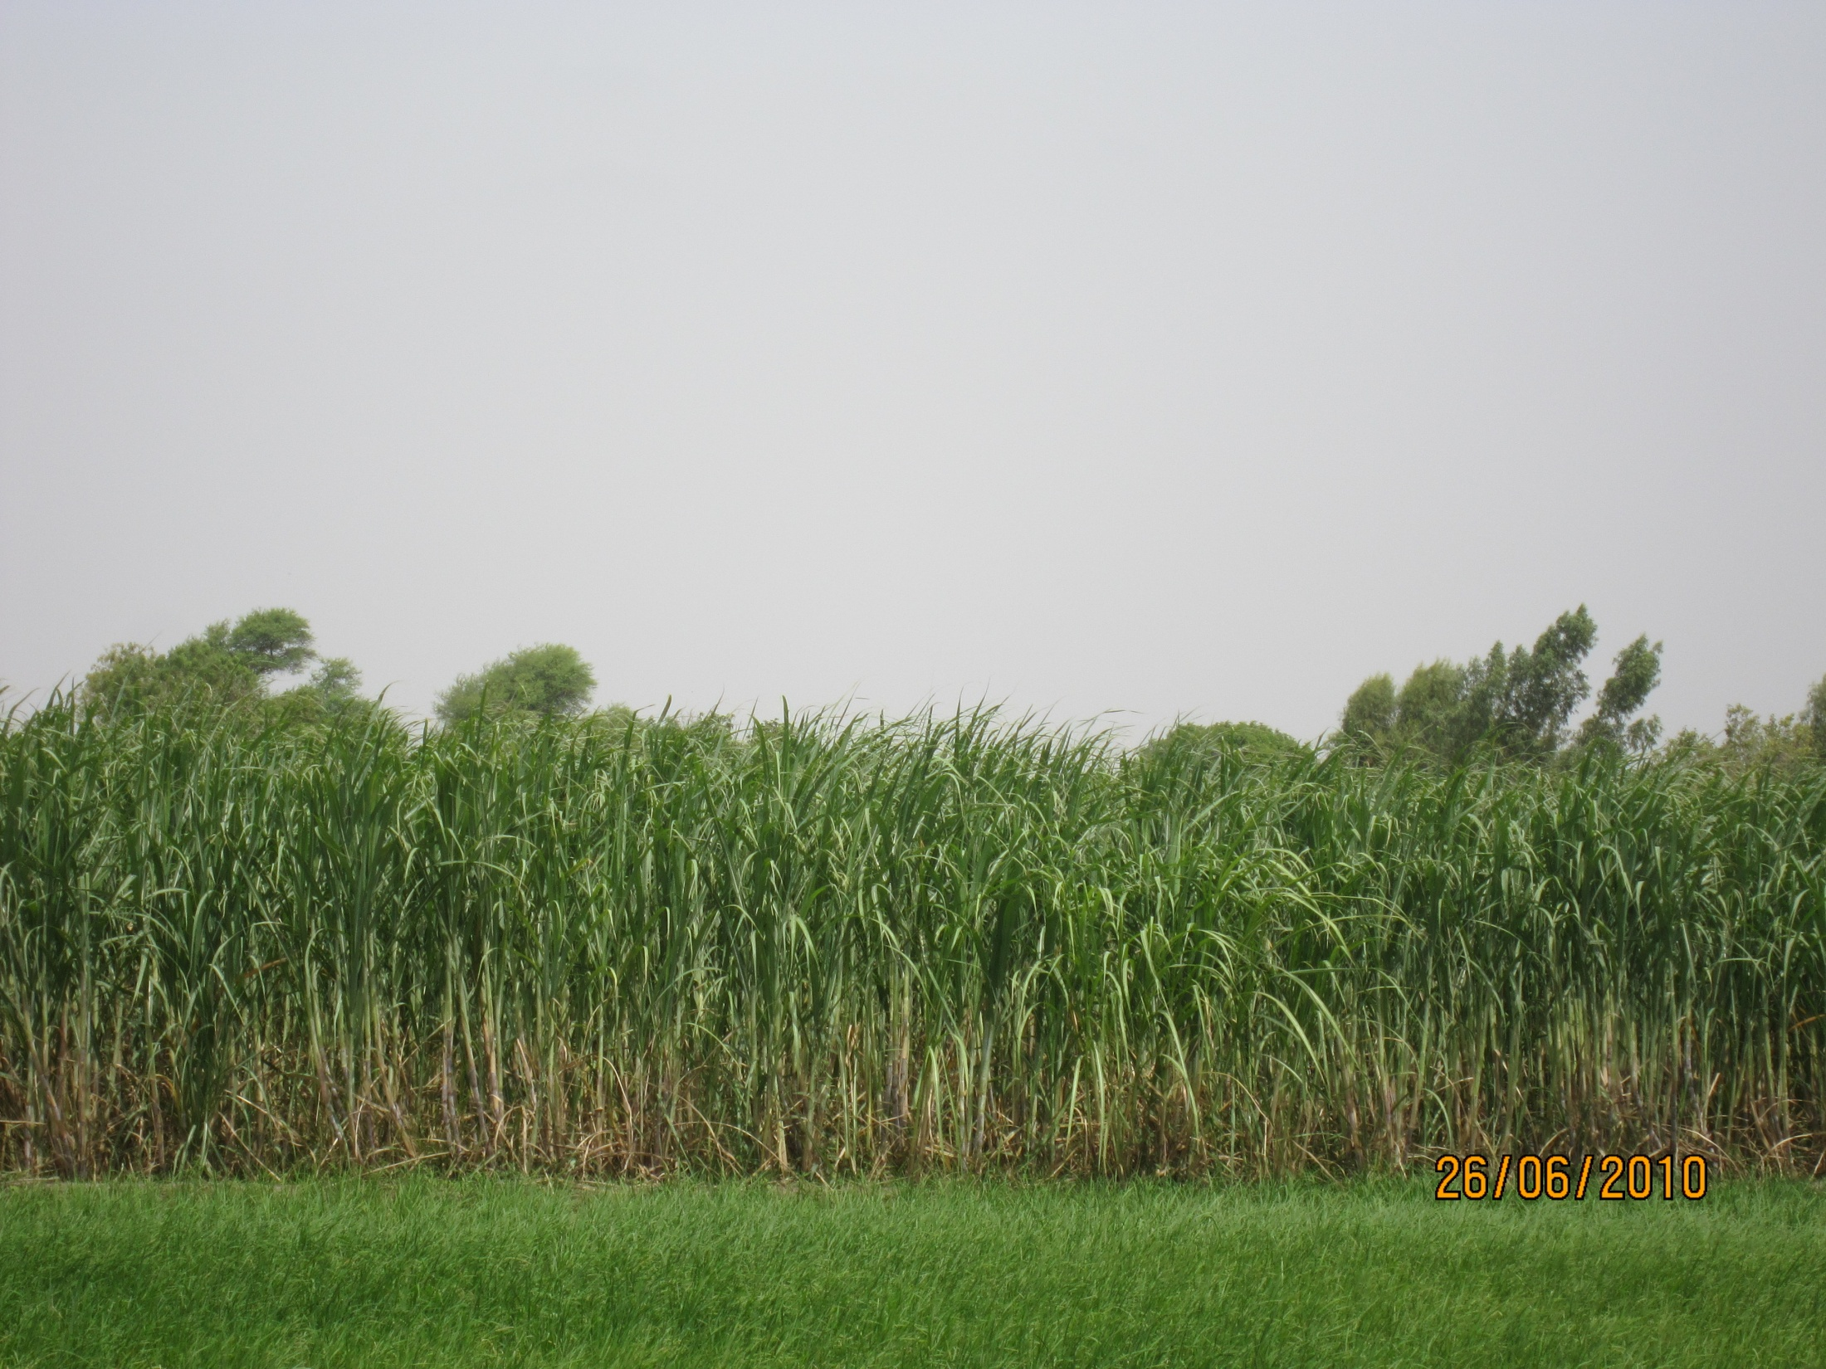
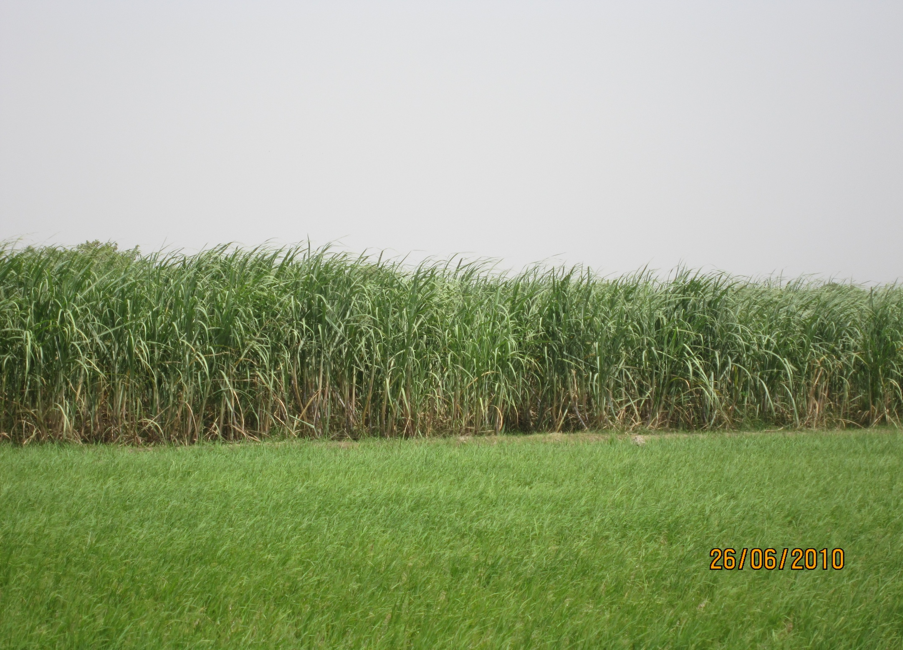
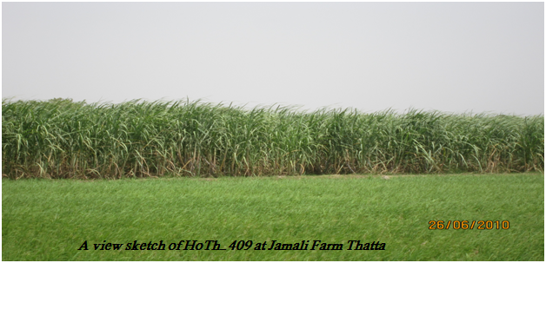
View of HoTh-409 at Jamali farm Jhirk site, Thatta
View of HoTh-409
View of HoTh-409

Slide 17
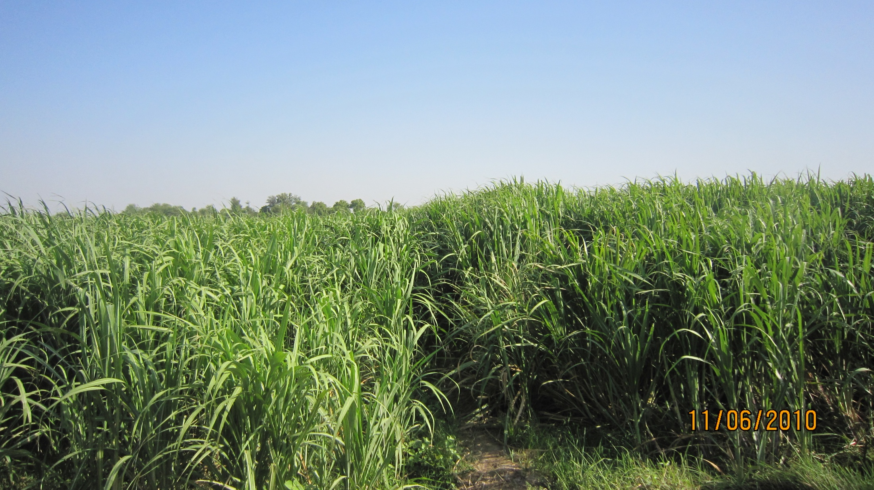
View of HoTh-409 at Jamali farm Jhirk site, Thatta
View of HoTh-409
View of HoTh-409

Slide 18
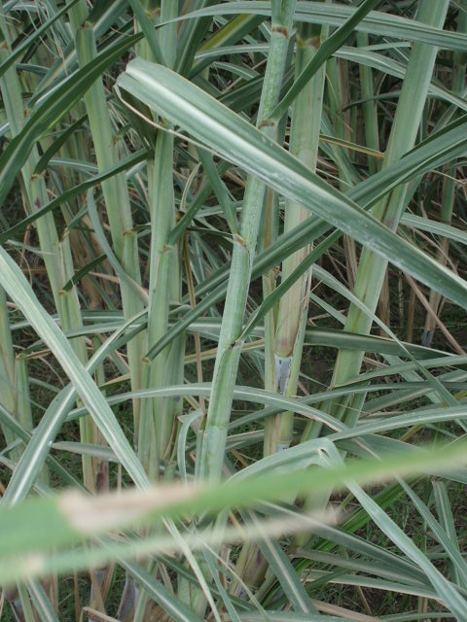
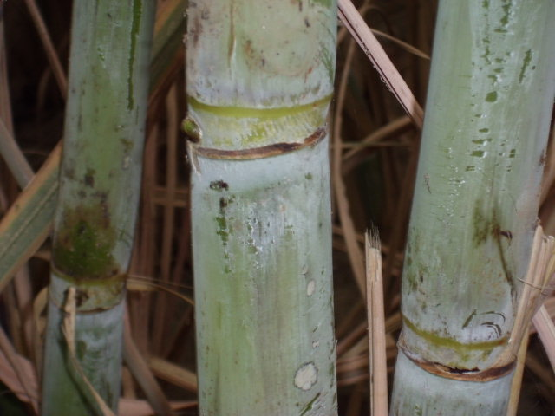
مهرباني
Thanks

